Slide 1
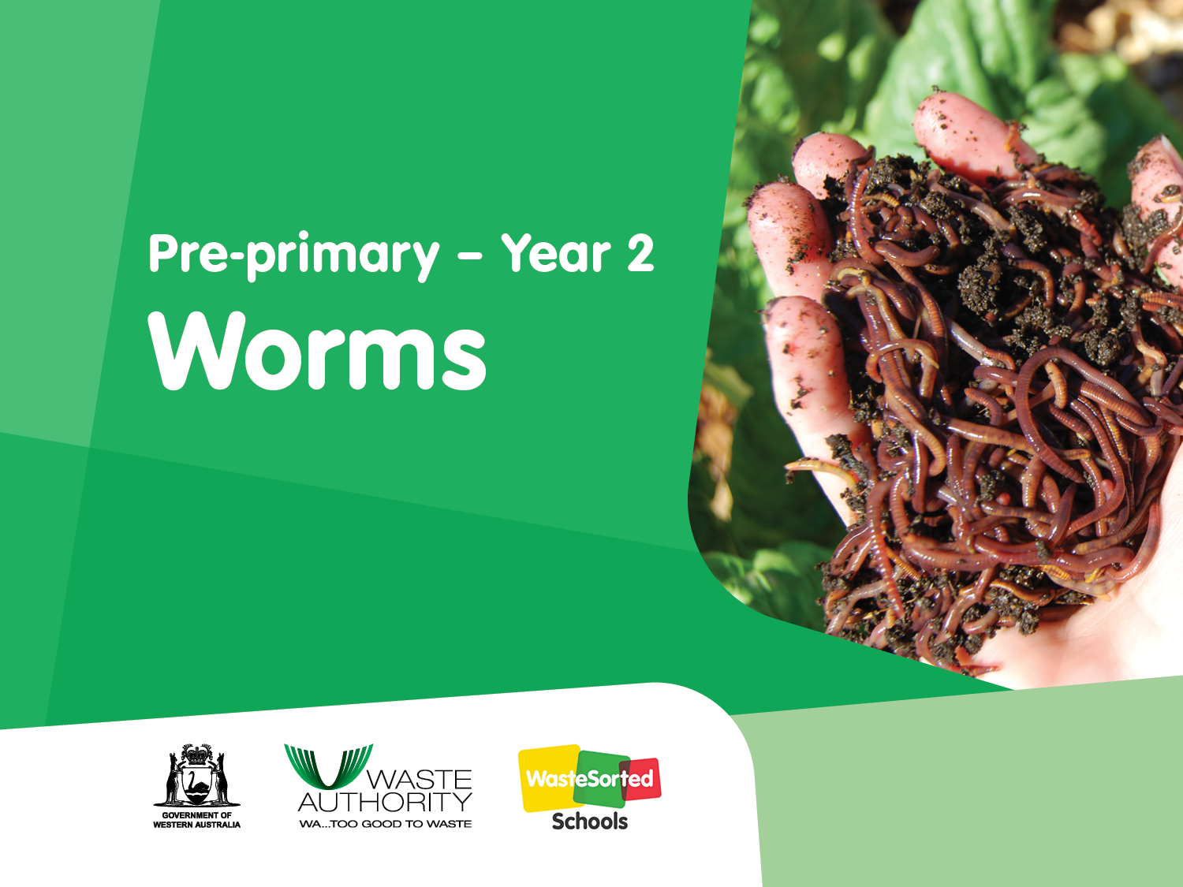

Slide 2
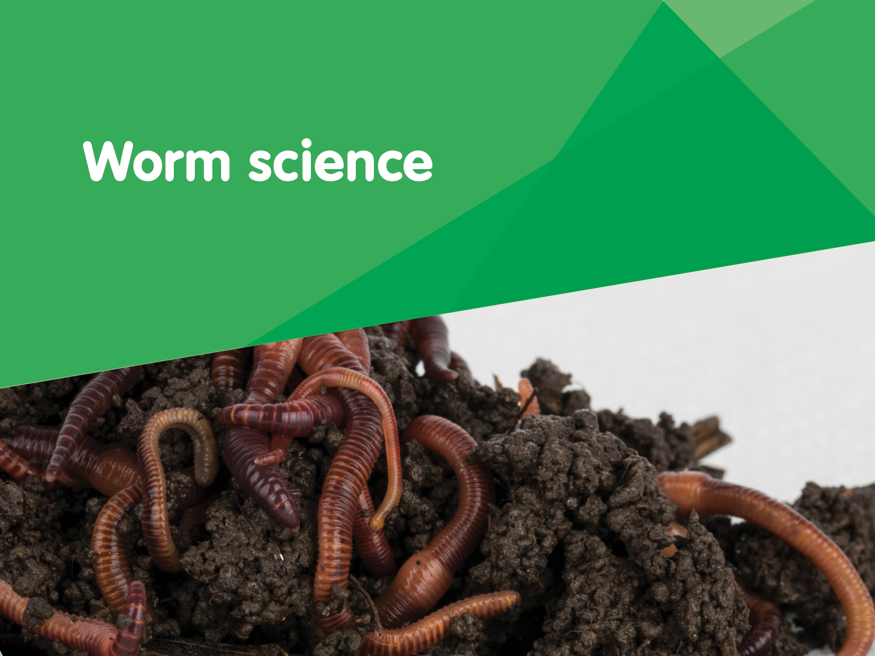

Slide 3
What do we know about worms?

Slide 4
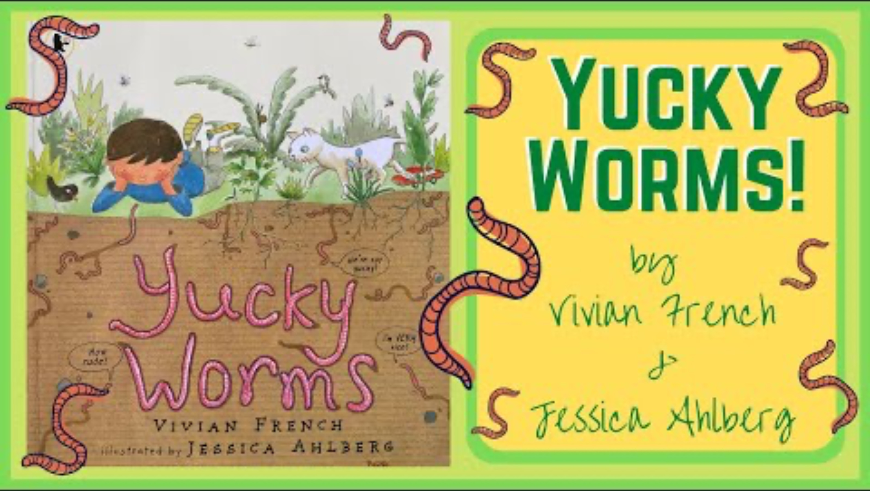
Yucky Worms!
Miss Mac reads Yucky Worms! - YouTube
After reading questions
Where do worms live?
What is different about worm bodies and human bodies?
What do worms eat?
How do worms help the garden?
Why can it be dangerous being a worm?
Why do worms come to the surface when it rains?
How do worms move?
Written by: Vivian French
Illustrations by: Jessica Ahlberg

Slide 5

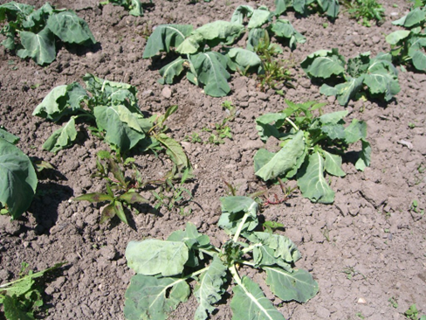
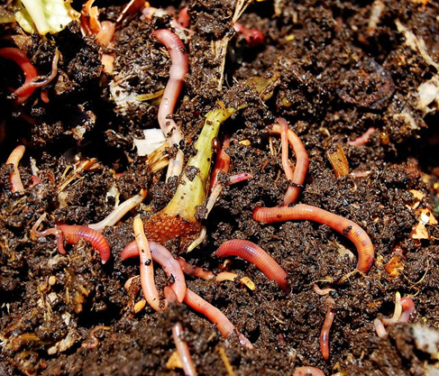
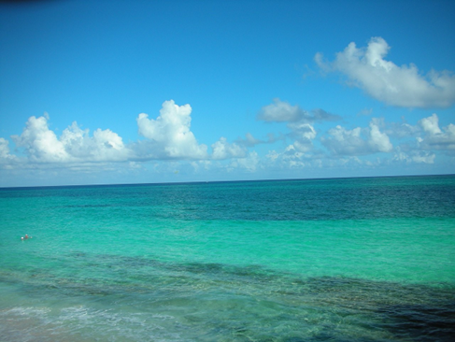
Where do worms live?
Sky
Vegetable garden
Compost
Beach
Why do they live here?

Slide 6
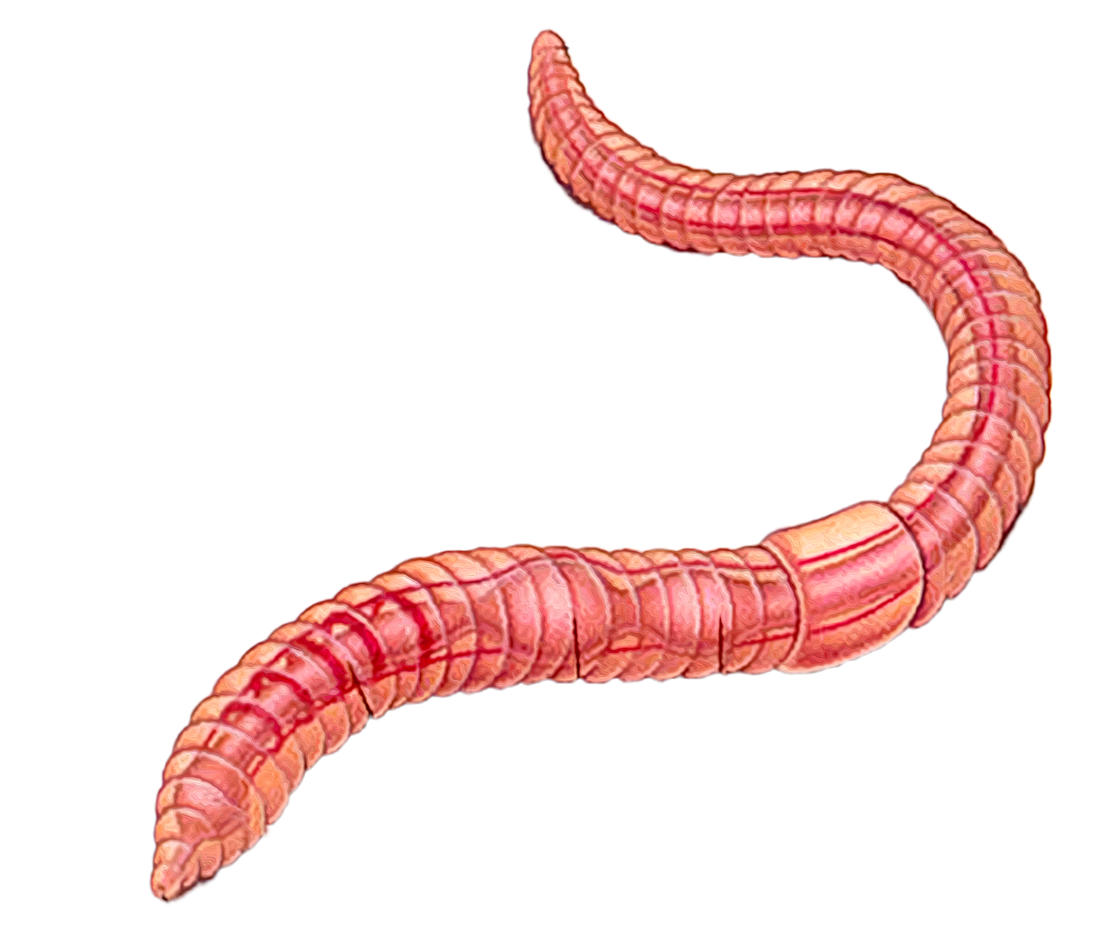
Anatomy of a worm
segments
tail
clitellum
5 hearts
mouth

Slide 7
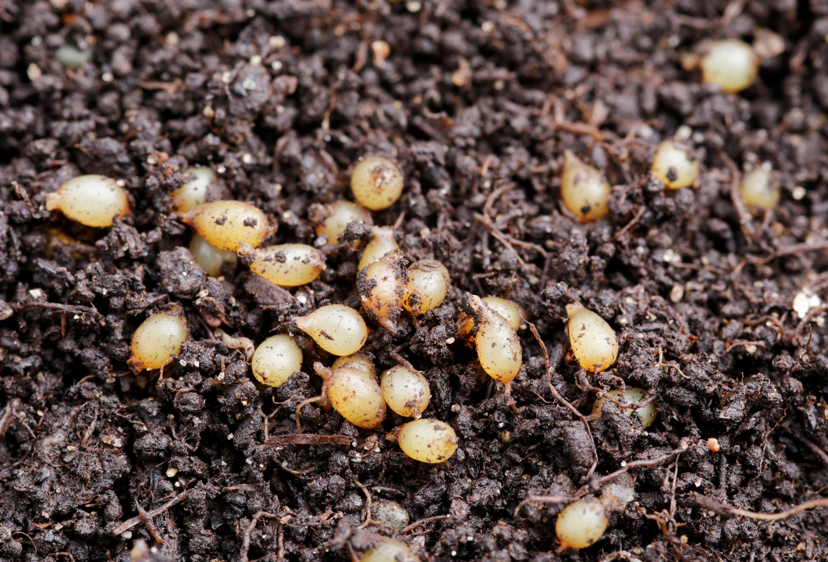
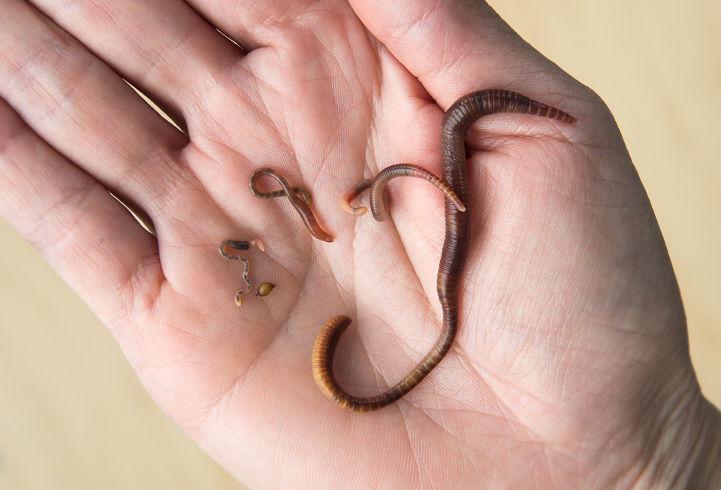

Looking at worms
Worms start life
in a cocoon.
One cocoon can have up to 20 juvenile worms inside.

Slide 8
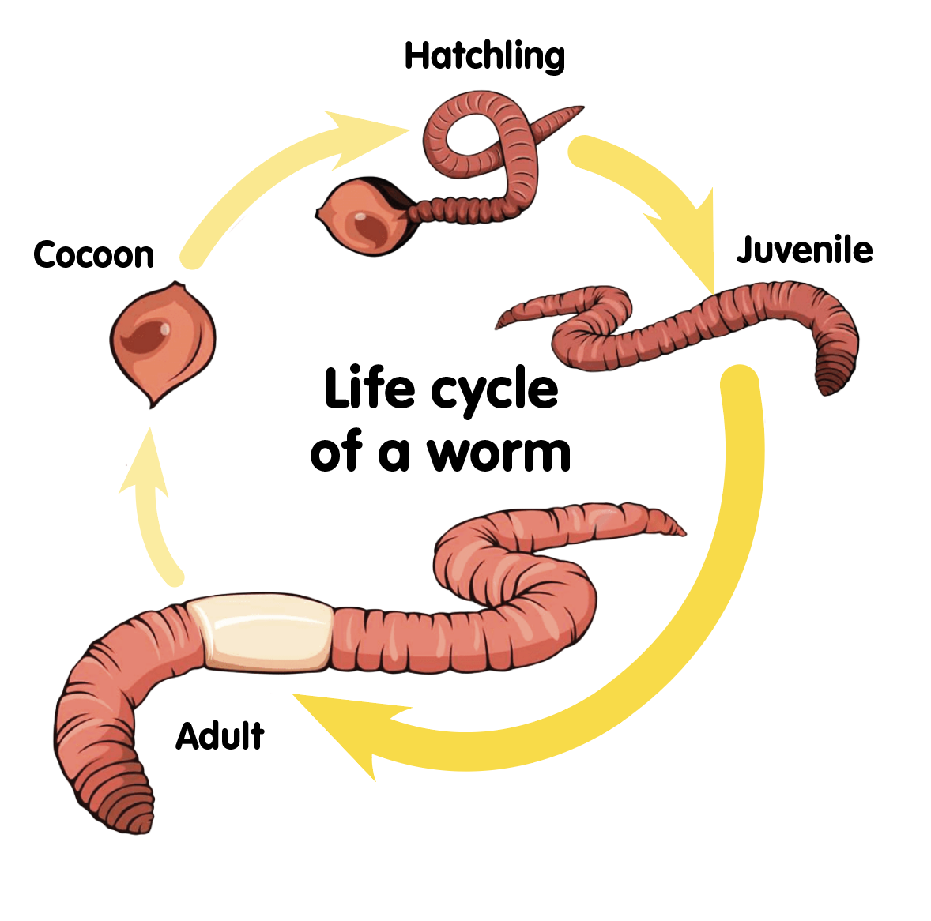
Life cycle of a worm
2
Once the eggs hatch, the young worms emerge from the cocoon as tiny, transparent threads known as hatchlings.
Worms begin their life cycle as eggs, which are laid in a protective cocoon.
1
3
Hatchlings grow quickly and develop into juveniles, where they start to resemble adults.
Adult worms are fully grown when they develop their clitellum, which is a thick band that encircles their body. They are now ready to reproduce.
4
Are all the worms the same size and colour?
Why do you think some worms are smaller than others?

Slide 9
Let’s investigate
1. Observe
Working with your partner, carefully examine your worm using the magnifying glass. What do you notice about its:
smell
colour
number of segments
does it have eyes, a nose, hair, or a mouth?
how does the worm’s skin feel?
do you think the worm has a skeleton?
how does the worm move?
2. Identify
Look for the different parts we saw labelled in the anatomy of a worm diagram.
3. Draw
Complete the worksheet or draw a labelled diagram of your worm.
4. Discuss
Compare your worm to another group’s. Are they all the same? Why might this be?
Making it digital
Take a photo of a worm and add text to label its body parts.
Use a voice record function to record your observations over the picture.

Slide 10
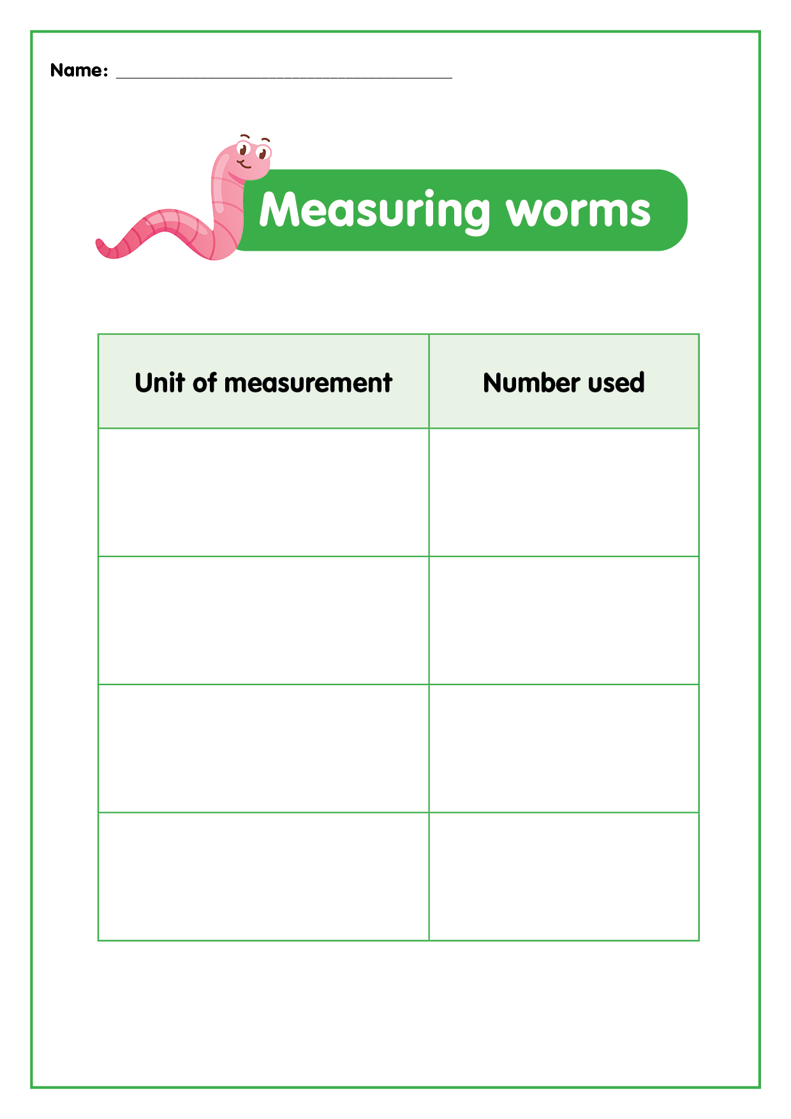
Let’s investigate
Measuring worms
1. Discuss
Let’s think about different things we could use to measure the worms.
(Remember the measuring tools must be the same length so that an accurate result can be recorded each time.)
3. Record
Record the results and add to the class table.
2. Measure
Using our selected measuring tools, let’s now measure a variety of worms.
4. Calculate
Calculate the average length of your class set of worms.

Slide 11
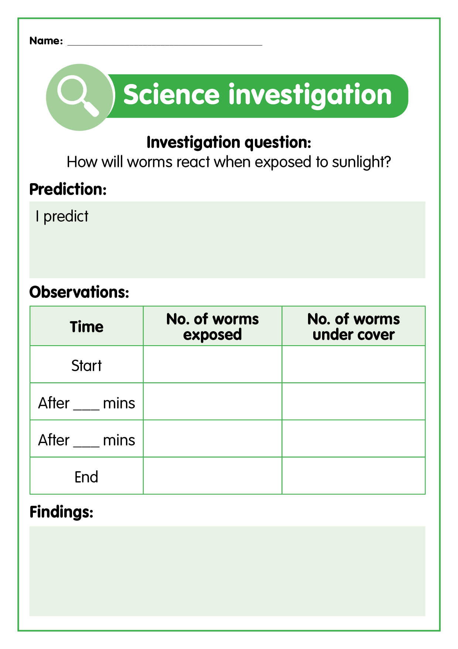
Let’s investigate
How worms respond to light
Place a thin layer of worm castings into a tray.
Cover half with an exercise book or piece of paper.
Gently place 10 or so earthworms around the uncovered side of the tray.
Predict, observe, record and explain what happens.

Slide 12
Let’s investigate
How will worms react when exposed to sunlight?
1. Predict
What do you think the worms exposed to light on the uncovered side of the tray will do?
3. Record
Where did most of the worms move to?
Did your observations match your prediction?
Did the worms move in the way you predicted?
2. Observe
Leave the worms for 15 to 20 minutes and then observe how and where they are moving.
4. Explain
Worms are sensitive to light and live underground. How do you think this relates to the way they moved in the experiment?

Slide 13

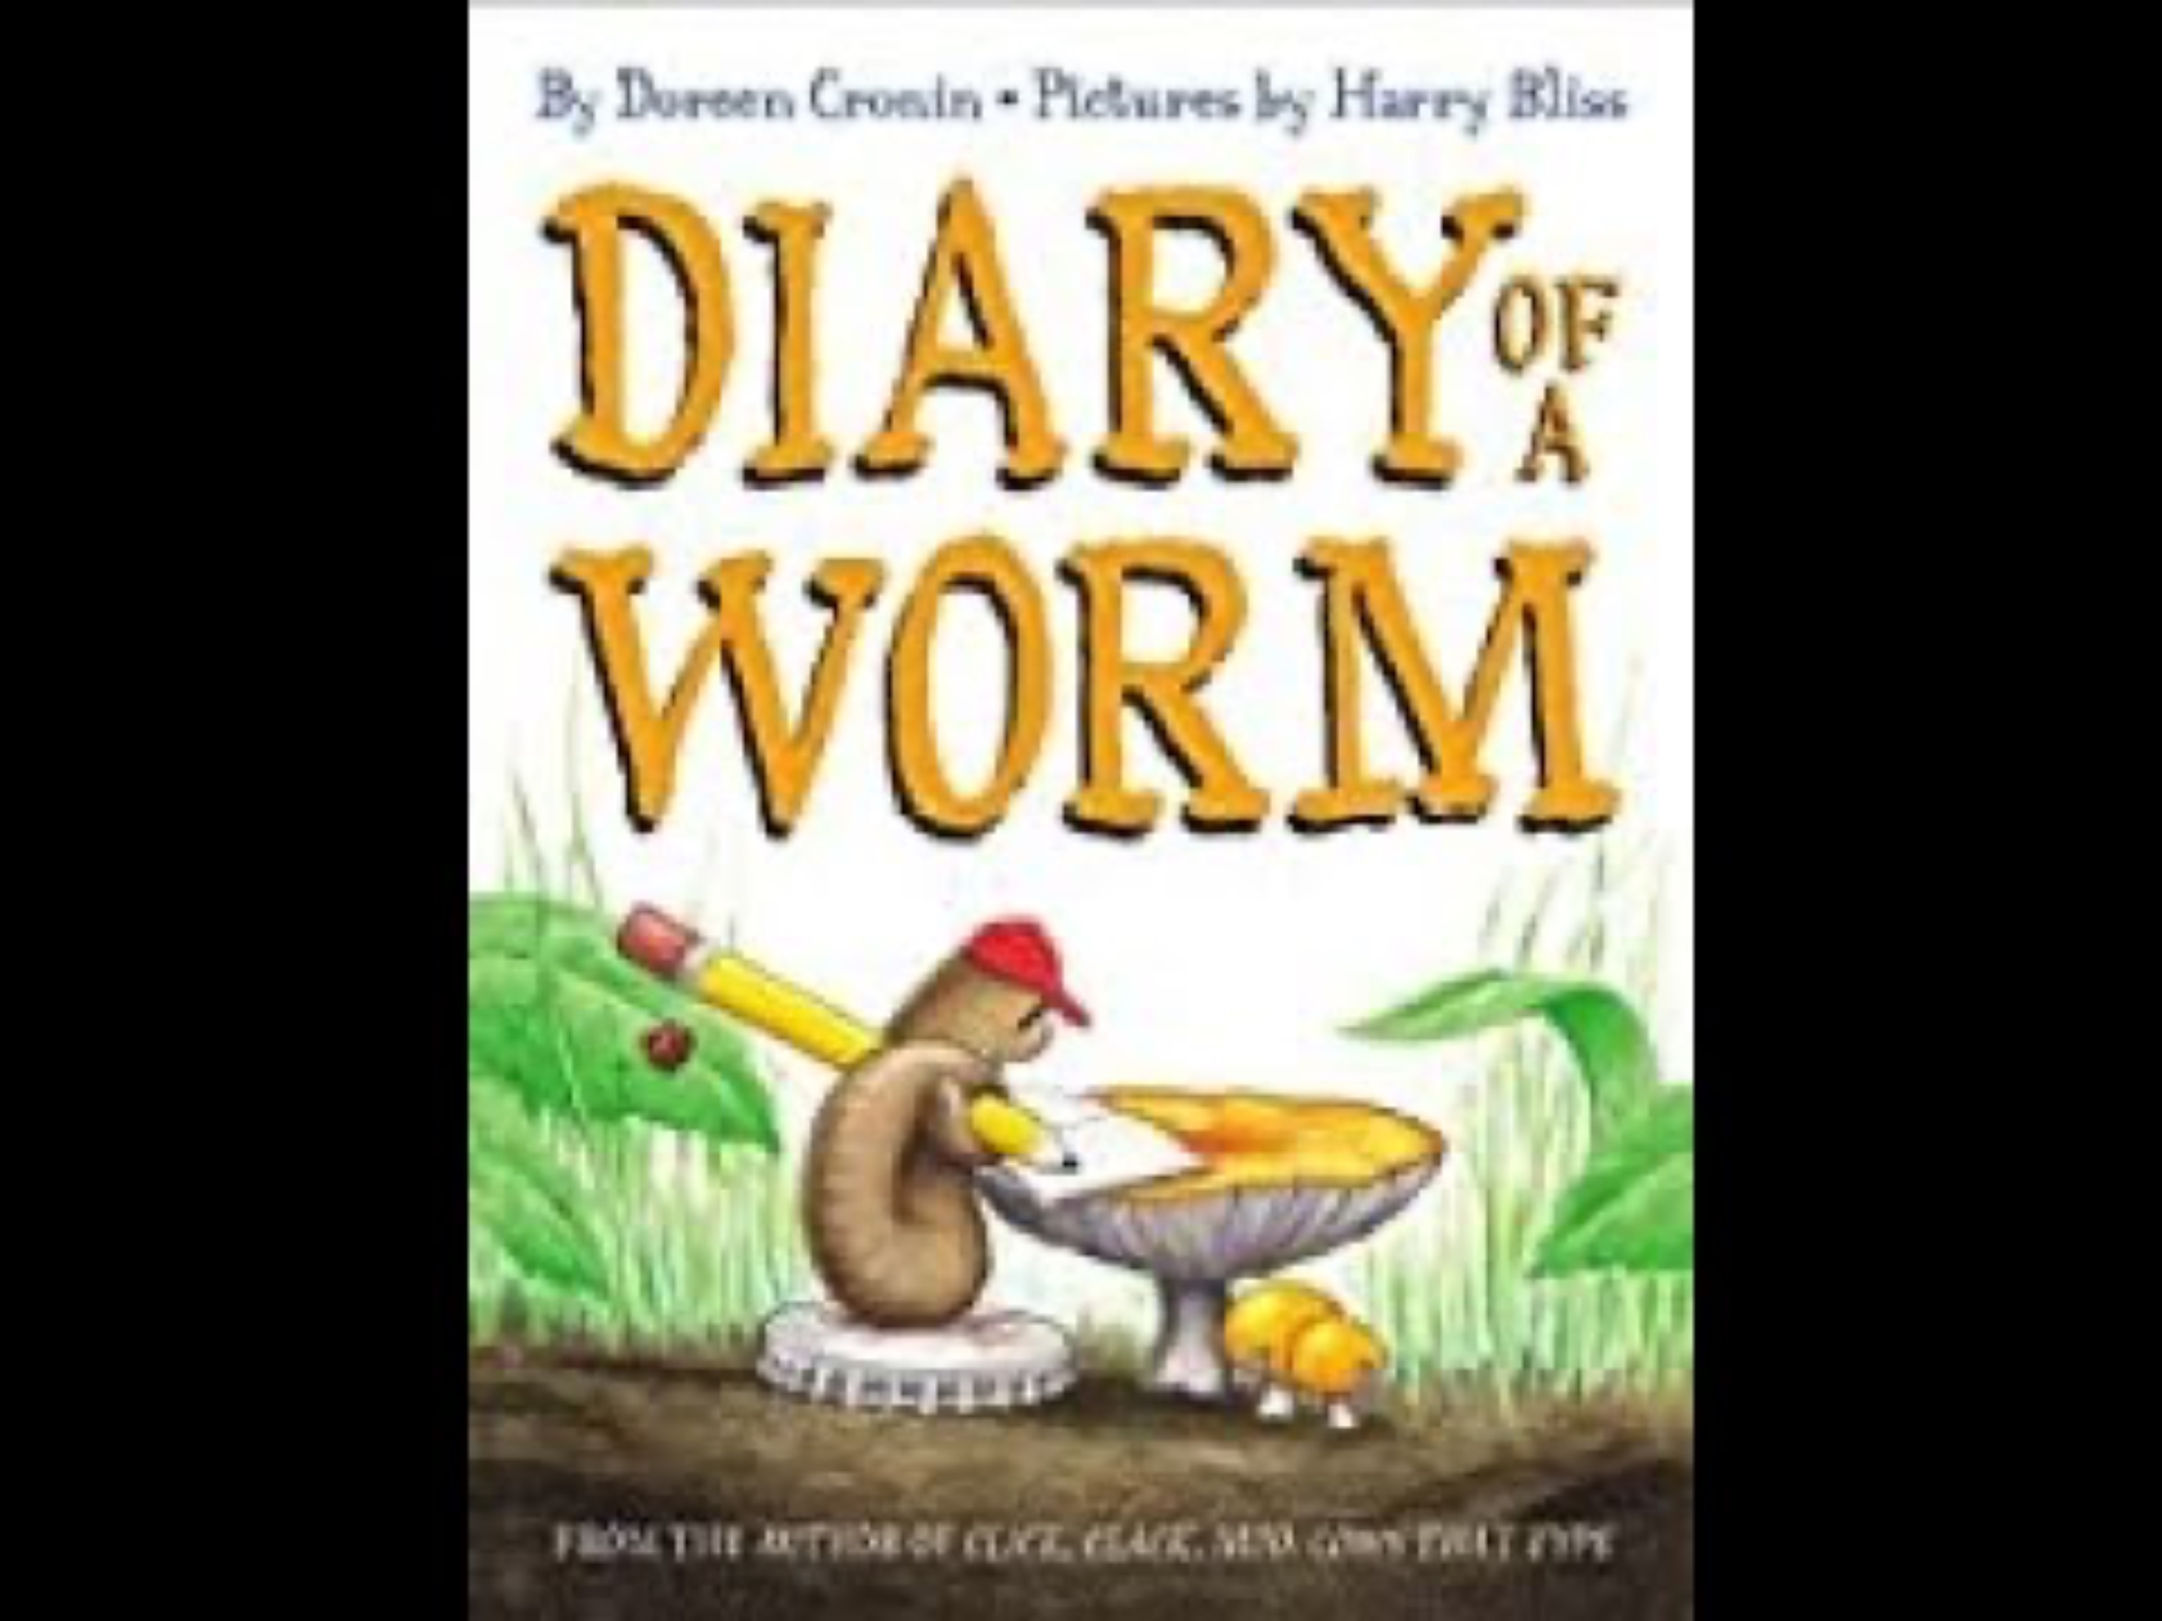
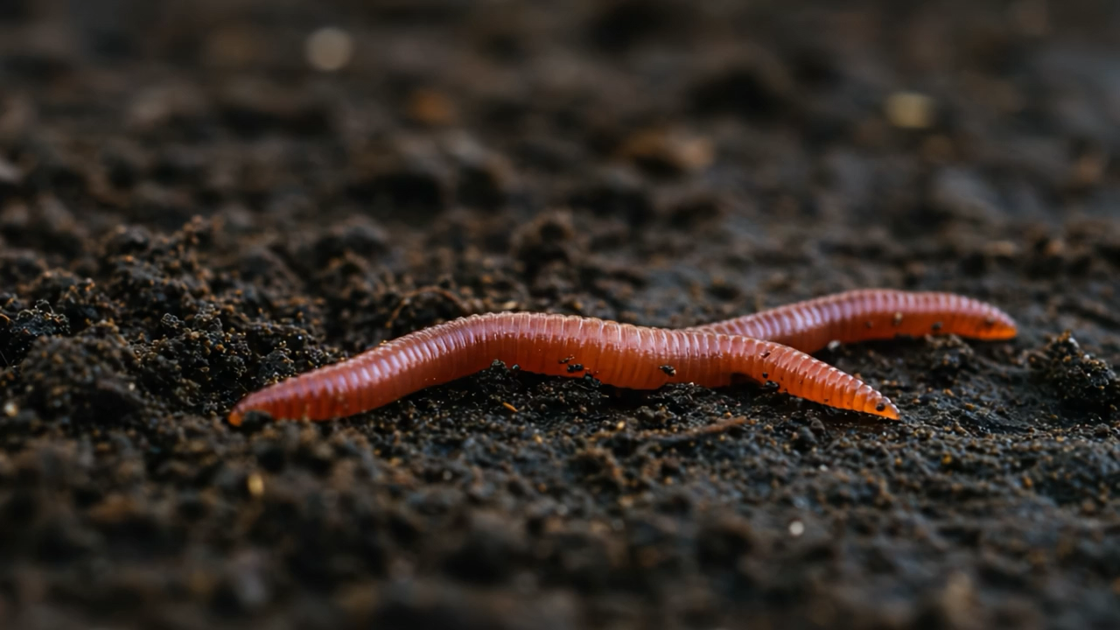
Diary of a Worm
Let’s read the book “Diary of a Worm” to find out more about the life of a worm.
How do we know that worms are living things?
they grow
they move
they take in nutrients when they eat
they poo (excretion)
they breathe (respiration)
they have babies (reproduce)
Diary of a Worm - YouTube
How do worms move?
Why do they move like this?
Let’s all try moving like a worm!
Written by: Doreen Cronin
Illustrations by: Harry Bliss

Slide 14
What have we learned about worms?

Slide 15
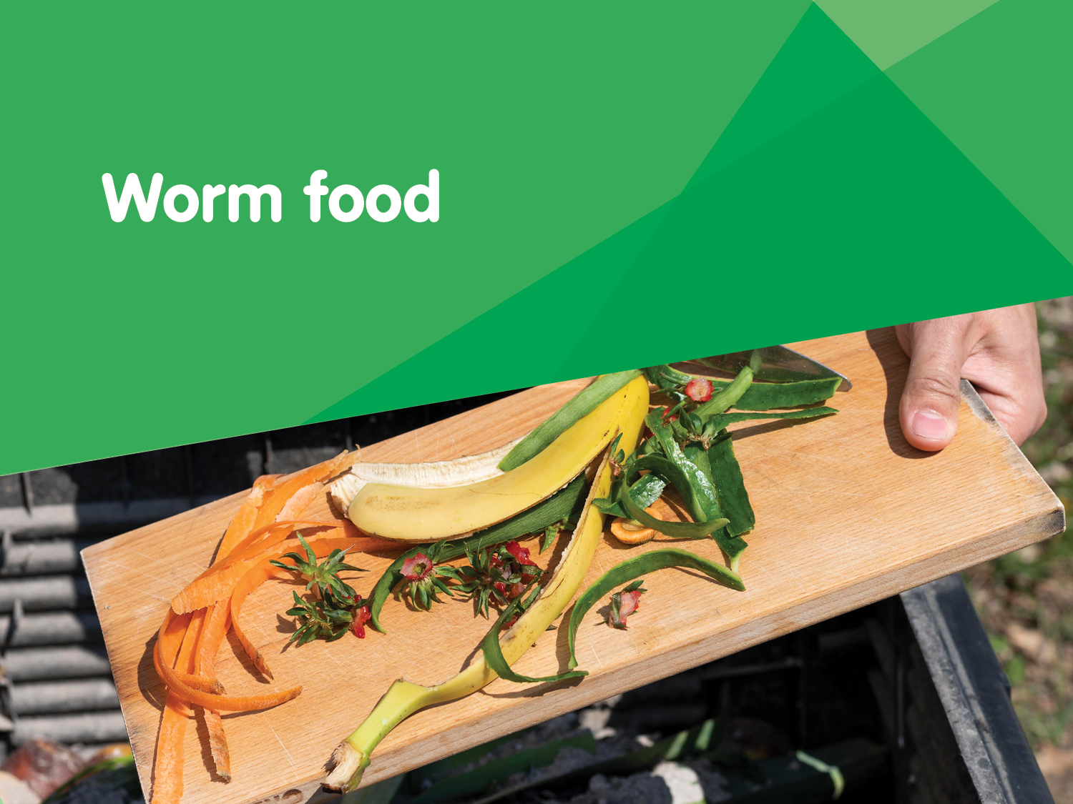

Slide 16
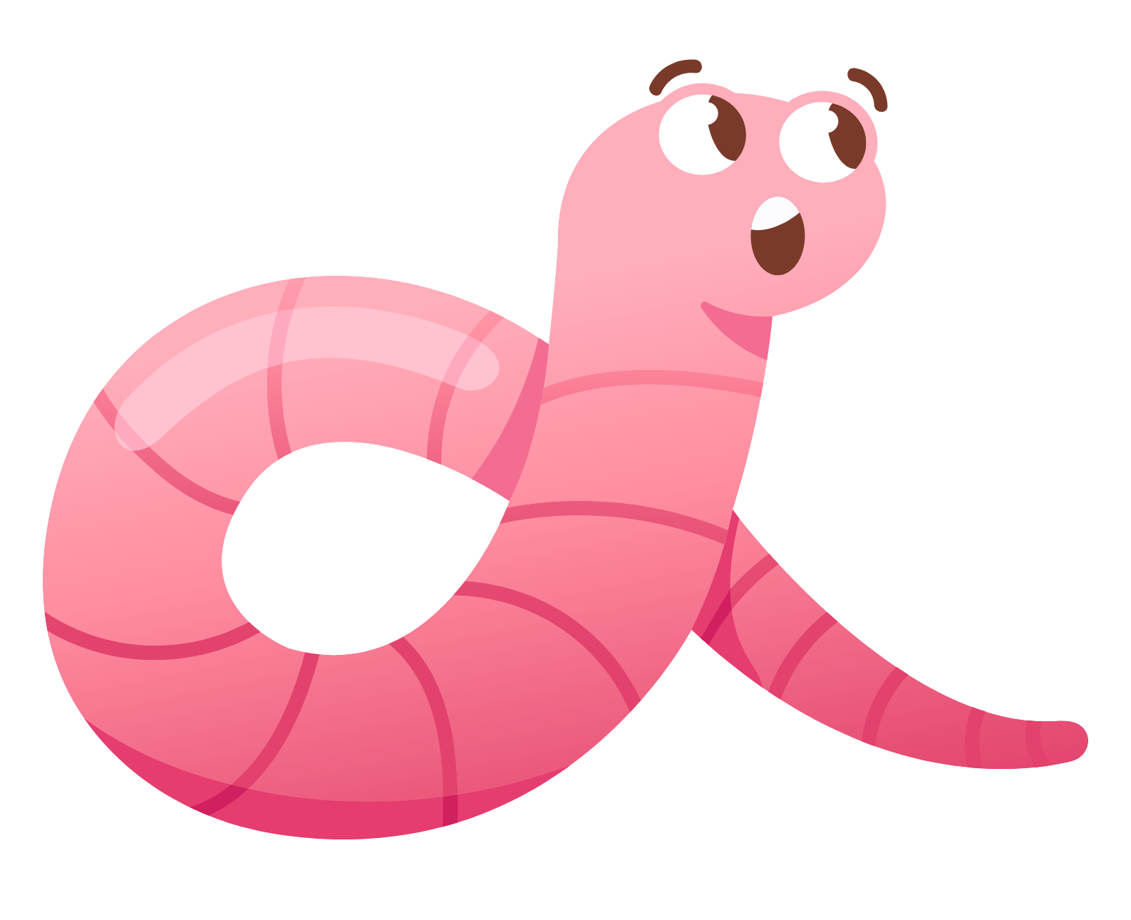
What do worms like to eat?

Slide 17
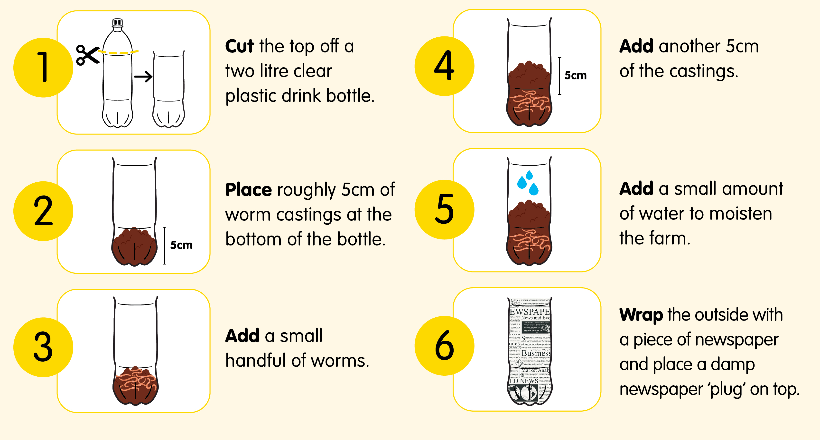
How to make a mini worm farm

Slide 18
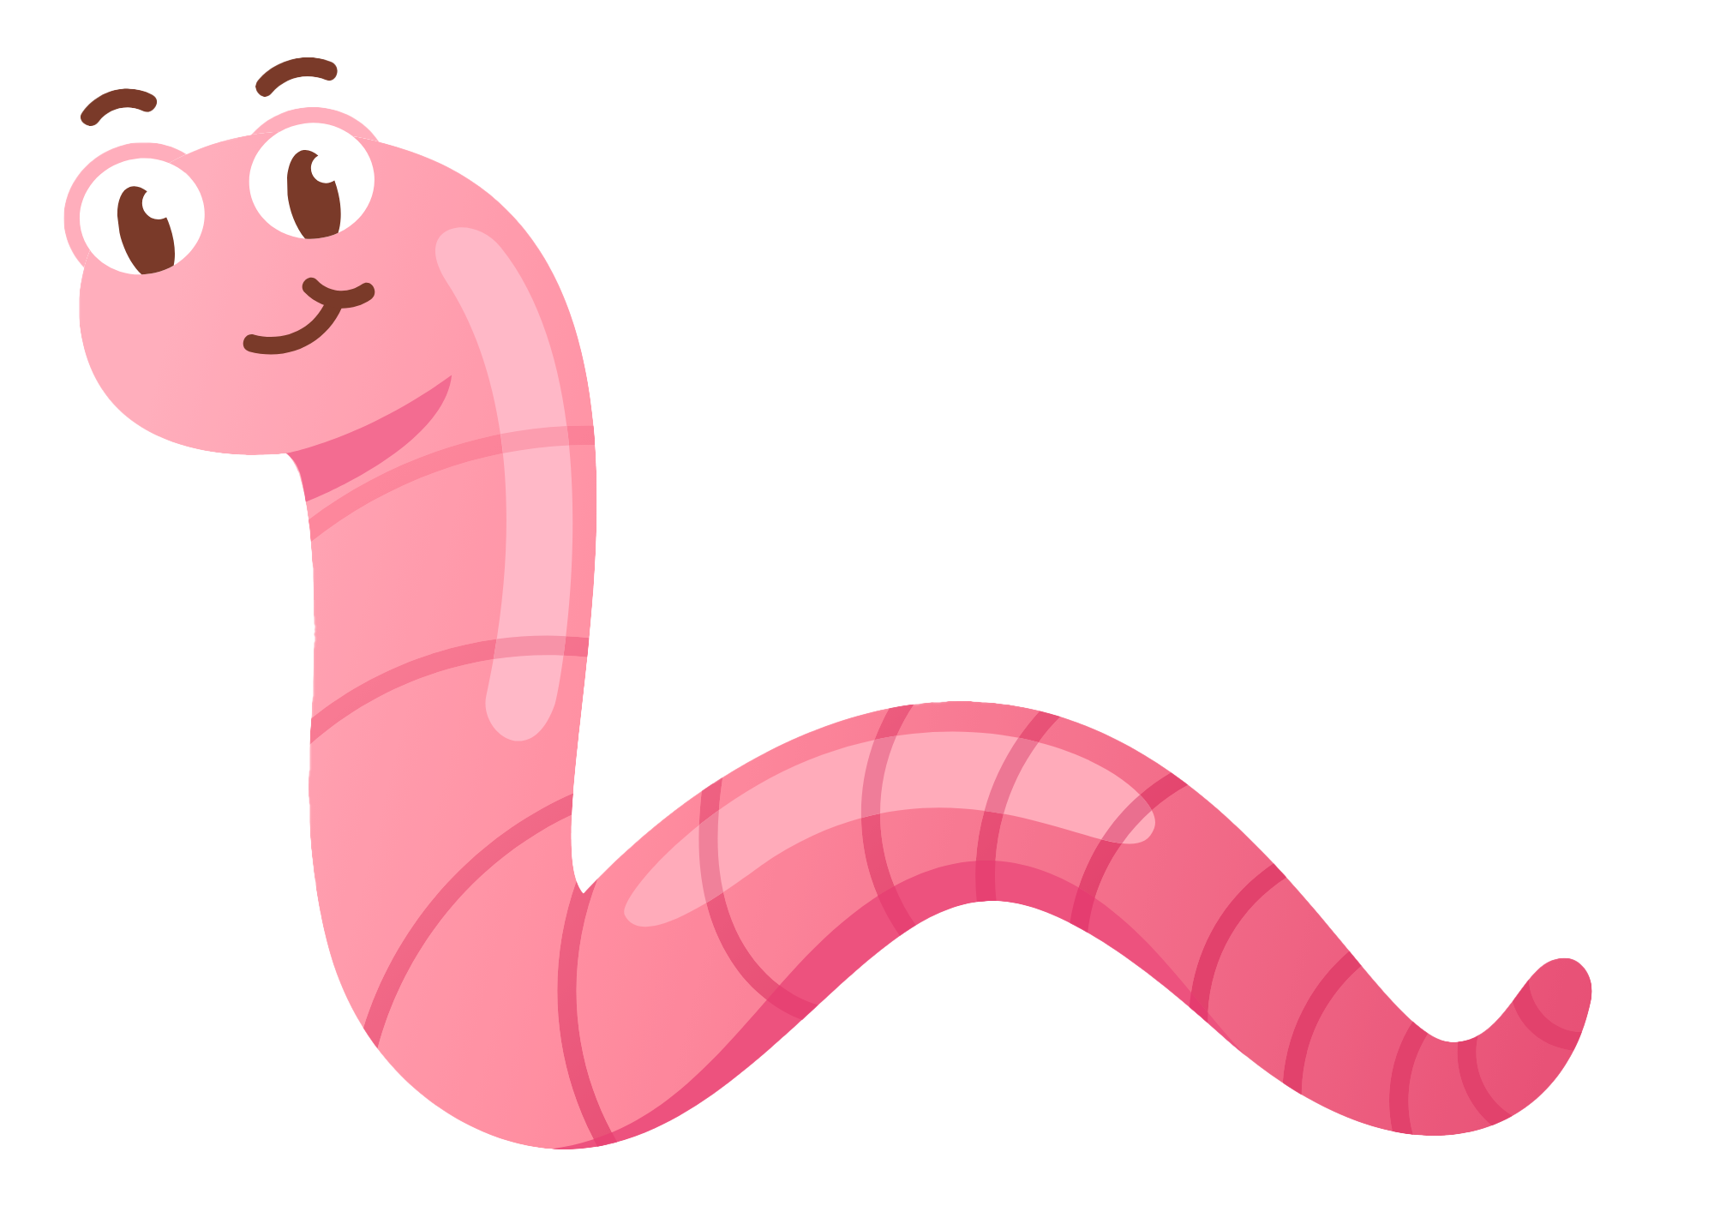
Let’s investigate
We are going to investigate which pieces of food will be eaten fastest between large, small, hard and soft.
1. Collect hard and soft fruit and vegetable scraps, e.g. banana and carrot, mango and apple core.
5. Clearly label each bottle with the type of food it contains.
6. Make sure that you can see the food through the side of the bottle and that it is covered in castings. Replace outside cover and newspaper plug on top.
2. Cut some scraps into small pieces and leave others large.
3. Carefully dig a small hole along the side of each container.
7. If necessary, add a small amount of water to moisten the soil.
4. Bury one type of food (large, small, hard, soft) in each bottle.
8. Check the worm farm every few days and record what you observe.
Let’s predict what we think will happen?

Slide 19
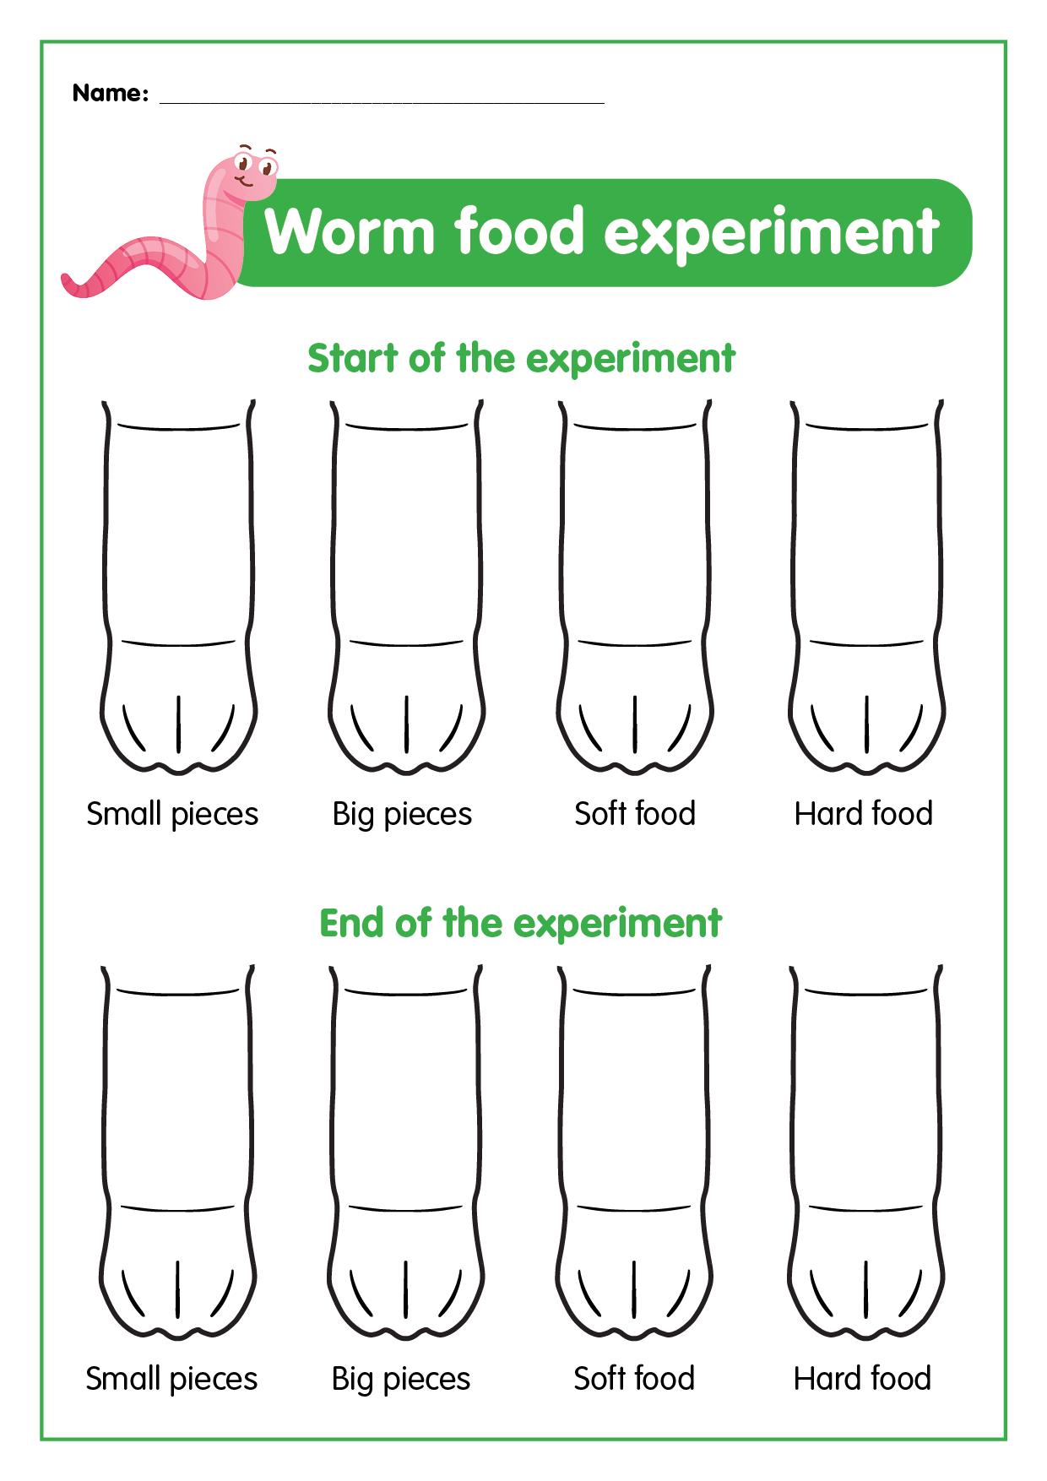
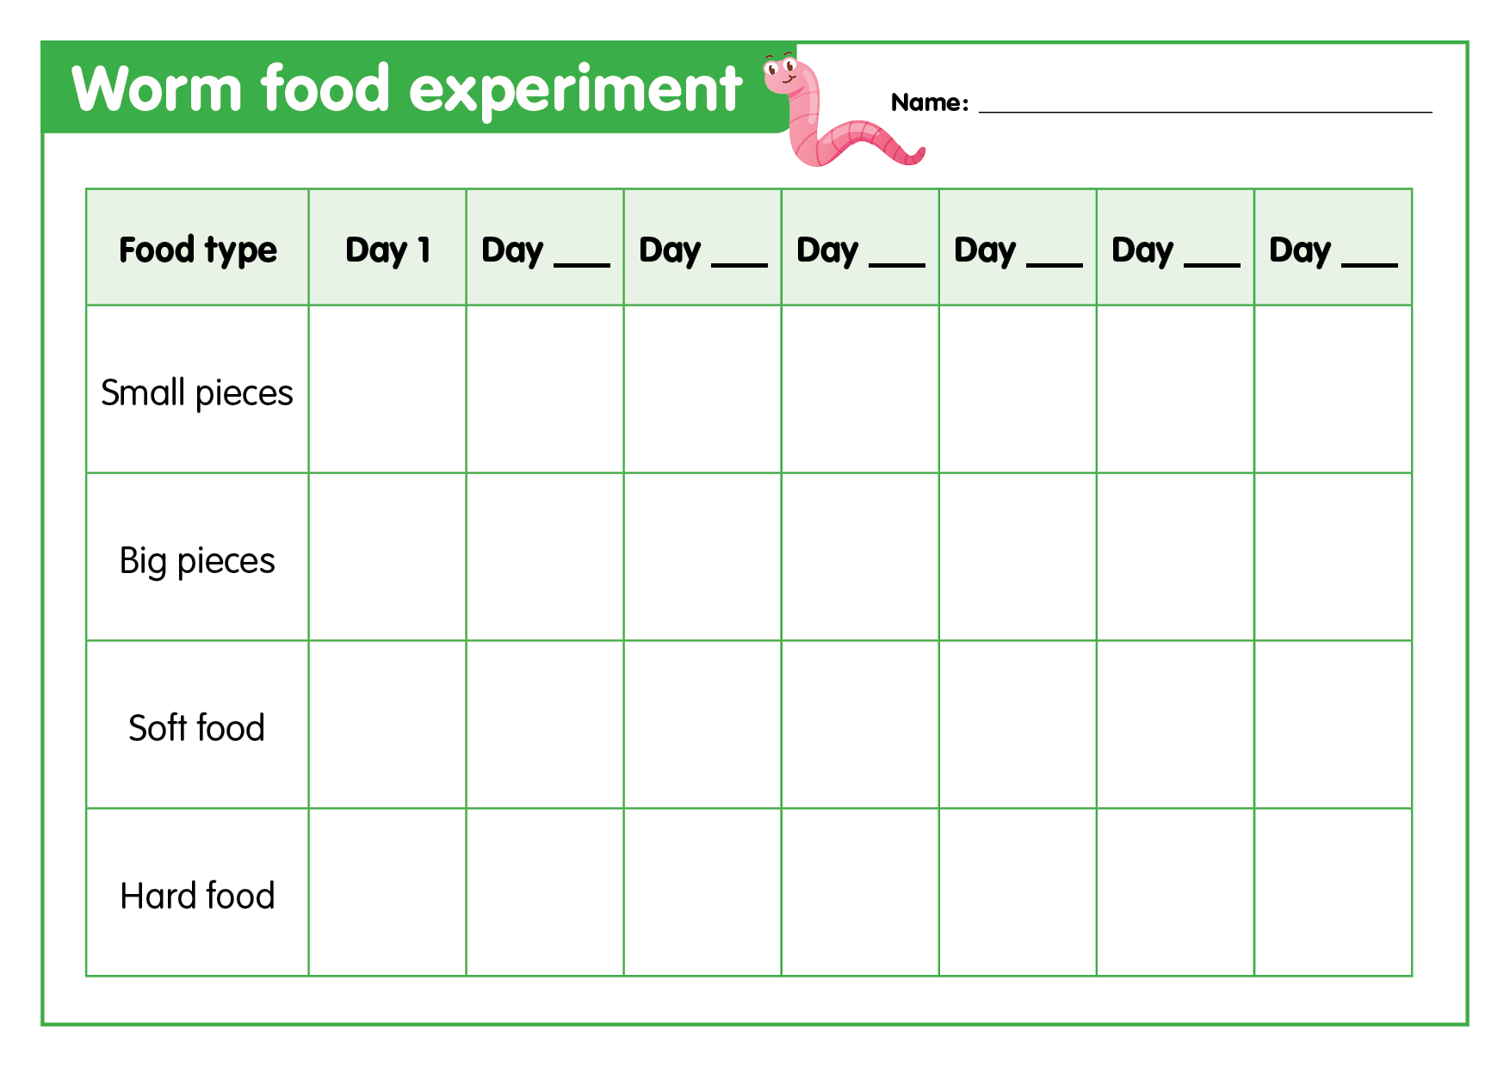
Let’s record
Check the mini worm farms every few days and record your observations on a table like the one shown.
Continue your observations until you can see changes happening.
Create a visual journal by drawing a picture of what the food looks like at the beginning and again each week until the end of the experiment.
Making it digital
Use a digital device to take photos of the food in the worm farm each week.
Import the photos into an app of your choosing and label them with the date they were taken to create a visual timeline of the food being eaten.

Slide 20
Let’s discuss
Which food was eaten the fastest?
Which food was eaten the slowest?
Did your findings match your predictions?
Why/why not?
What happens to food scraps when they go into a worm farm?
How do worms turn organic matter into castings?
What living conditions do worms like?
Why is a worm farm a suitable place for worms to live?

Slide 21
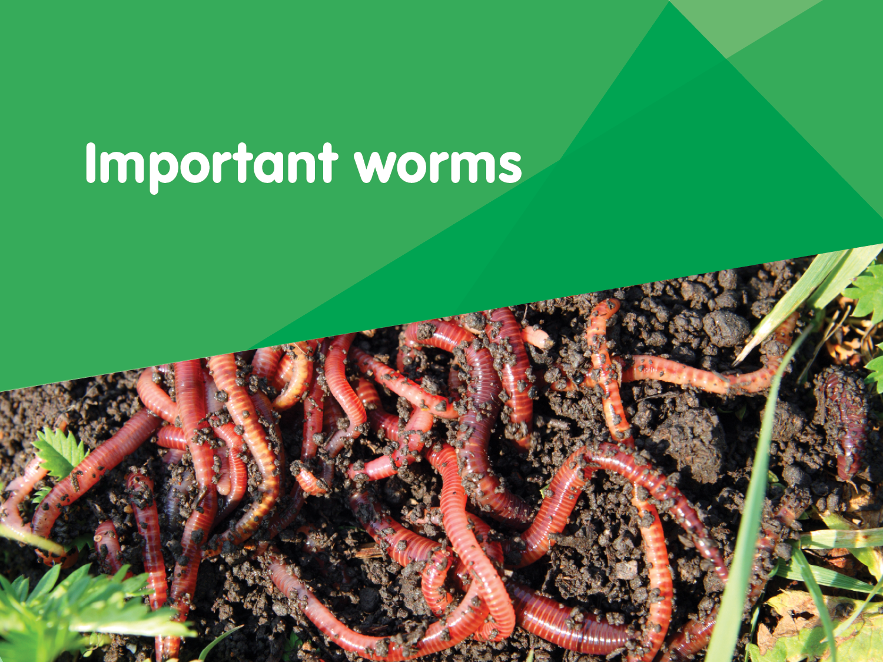

Slide 22
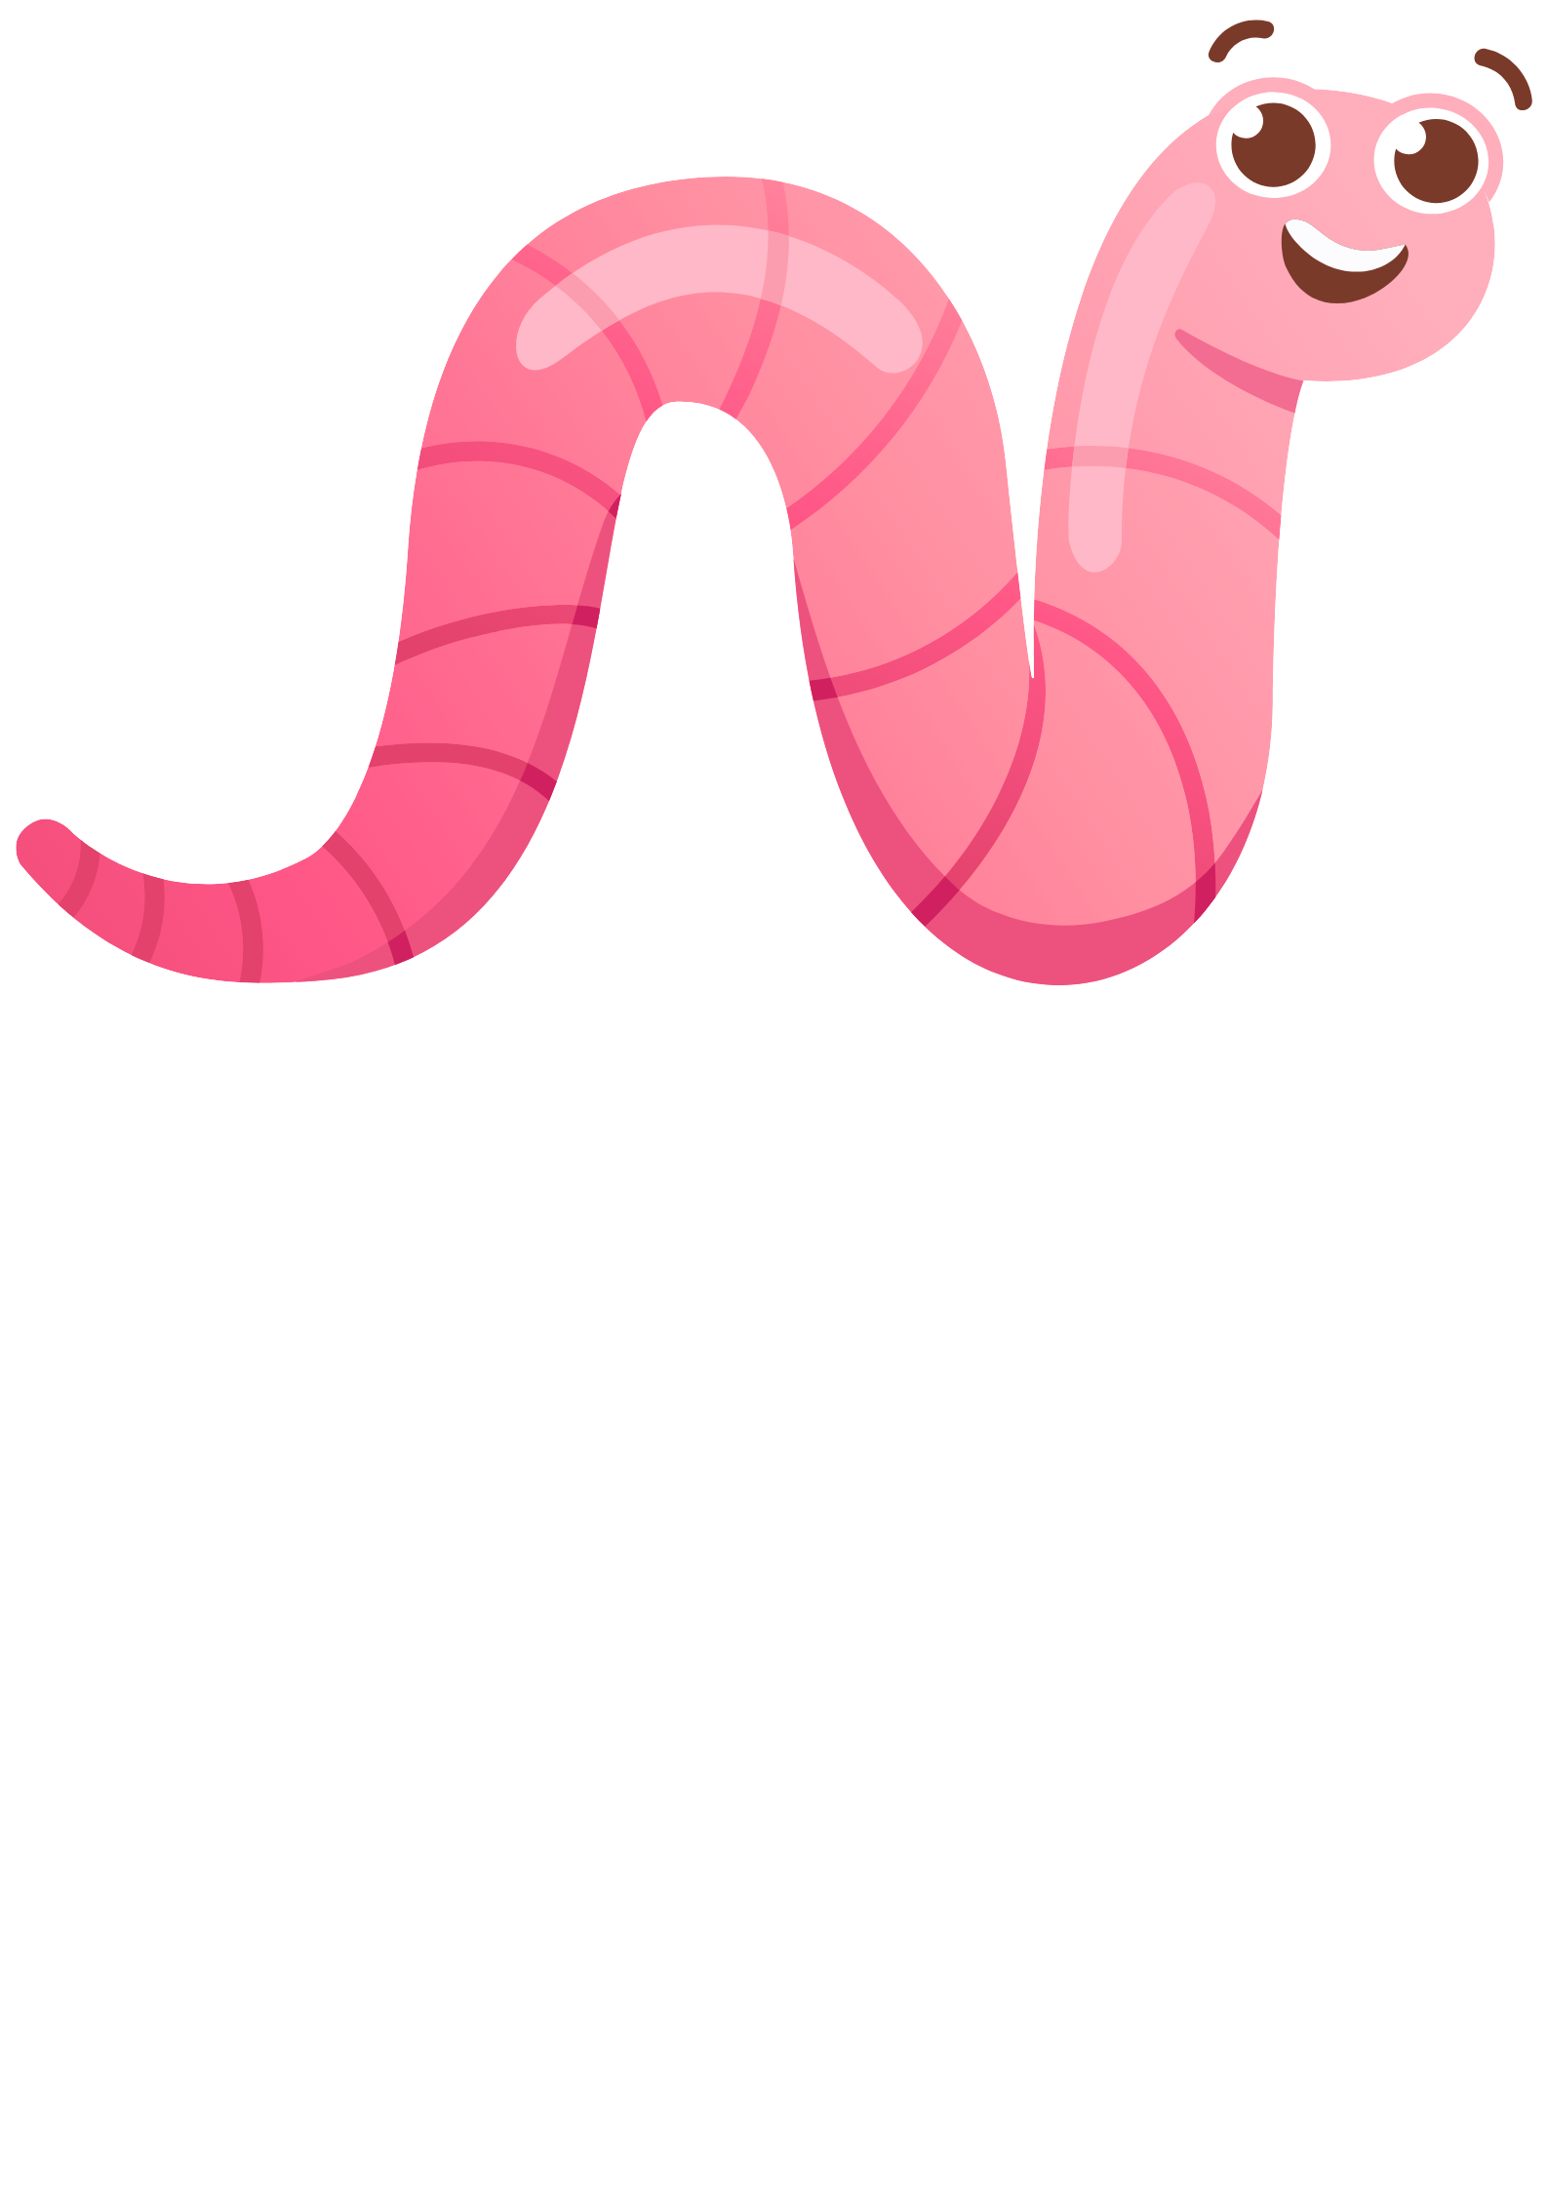
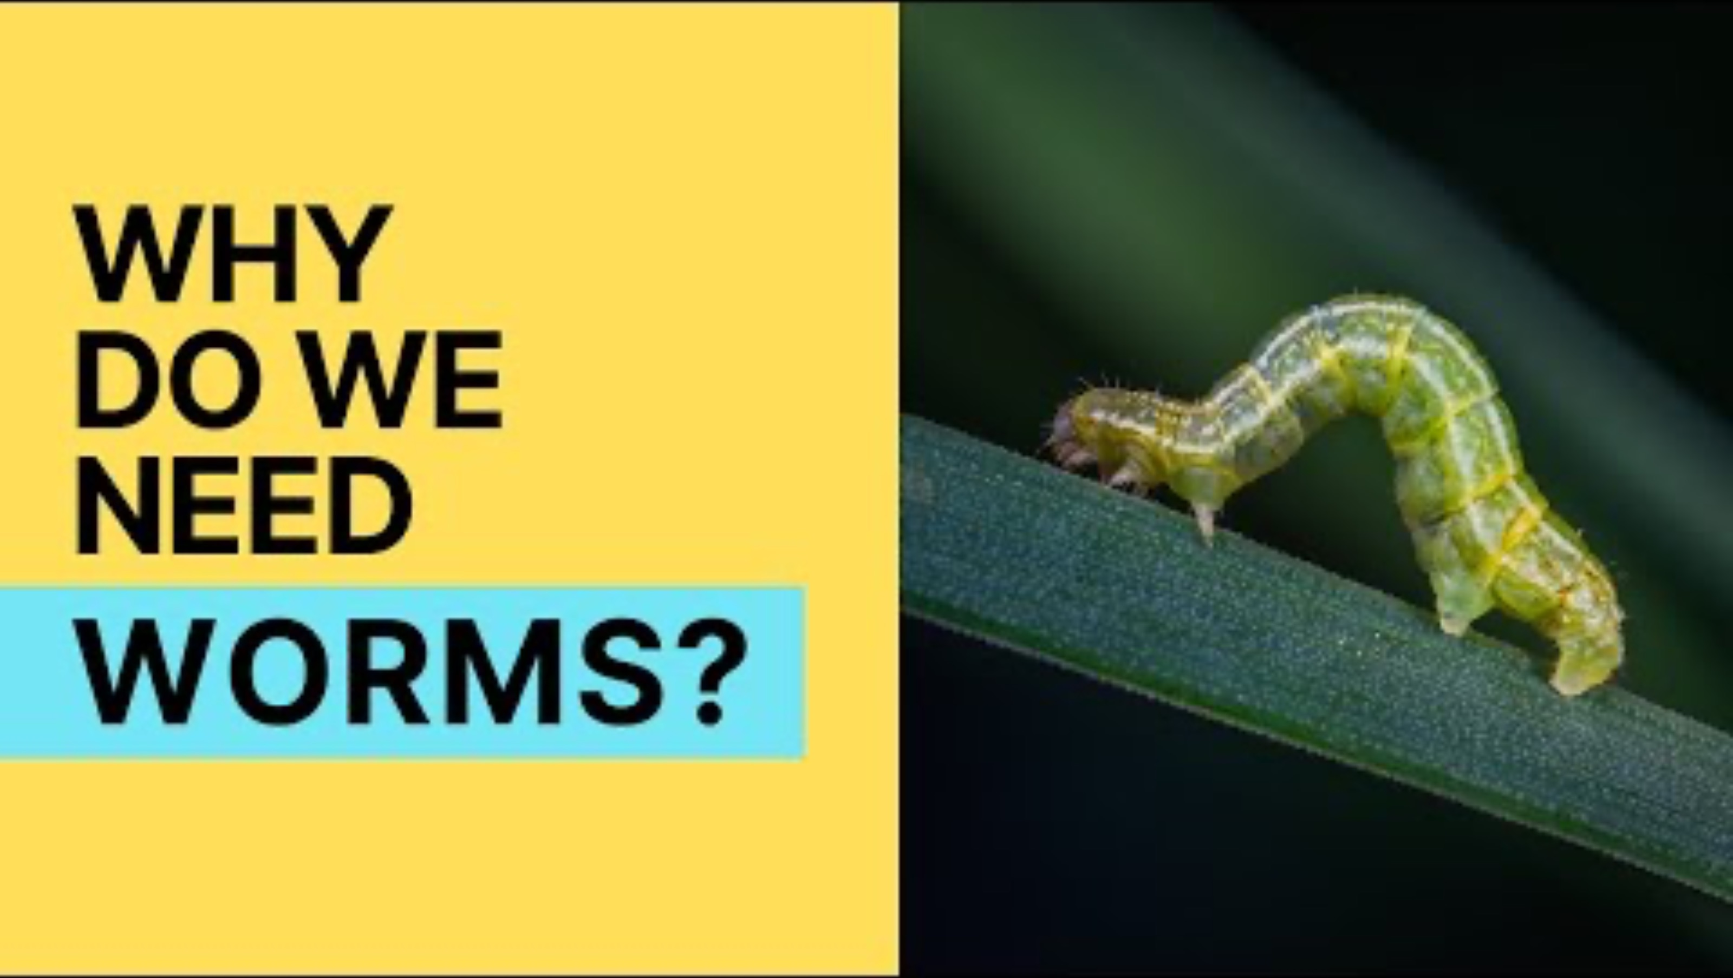
Let’s discuss
Why are worms so important?
Why do we need worms on Earth? - YouTube
Worms make tunnels when they move through the soil. The tunnels loosen the soil for plant roots, and help air and water move into the ground.
They poo and wee in the soil. The worm poo is called castings and worm wee is called leachate. The worm castings and leachate add goodness (nutrients) to the soil.
Worms eat lots of organic waste, things like old plants, fallen leaves and food scraps.
Worms live in the ground, they are little ‘soil farmers’.

Slide 23
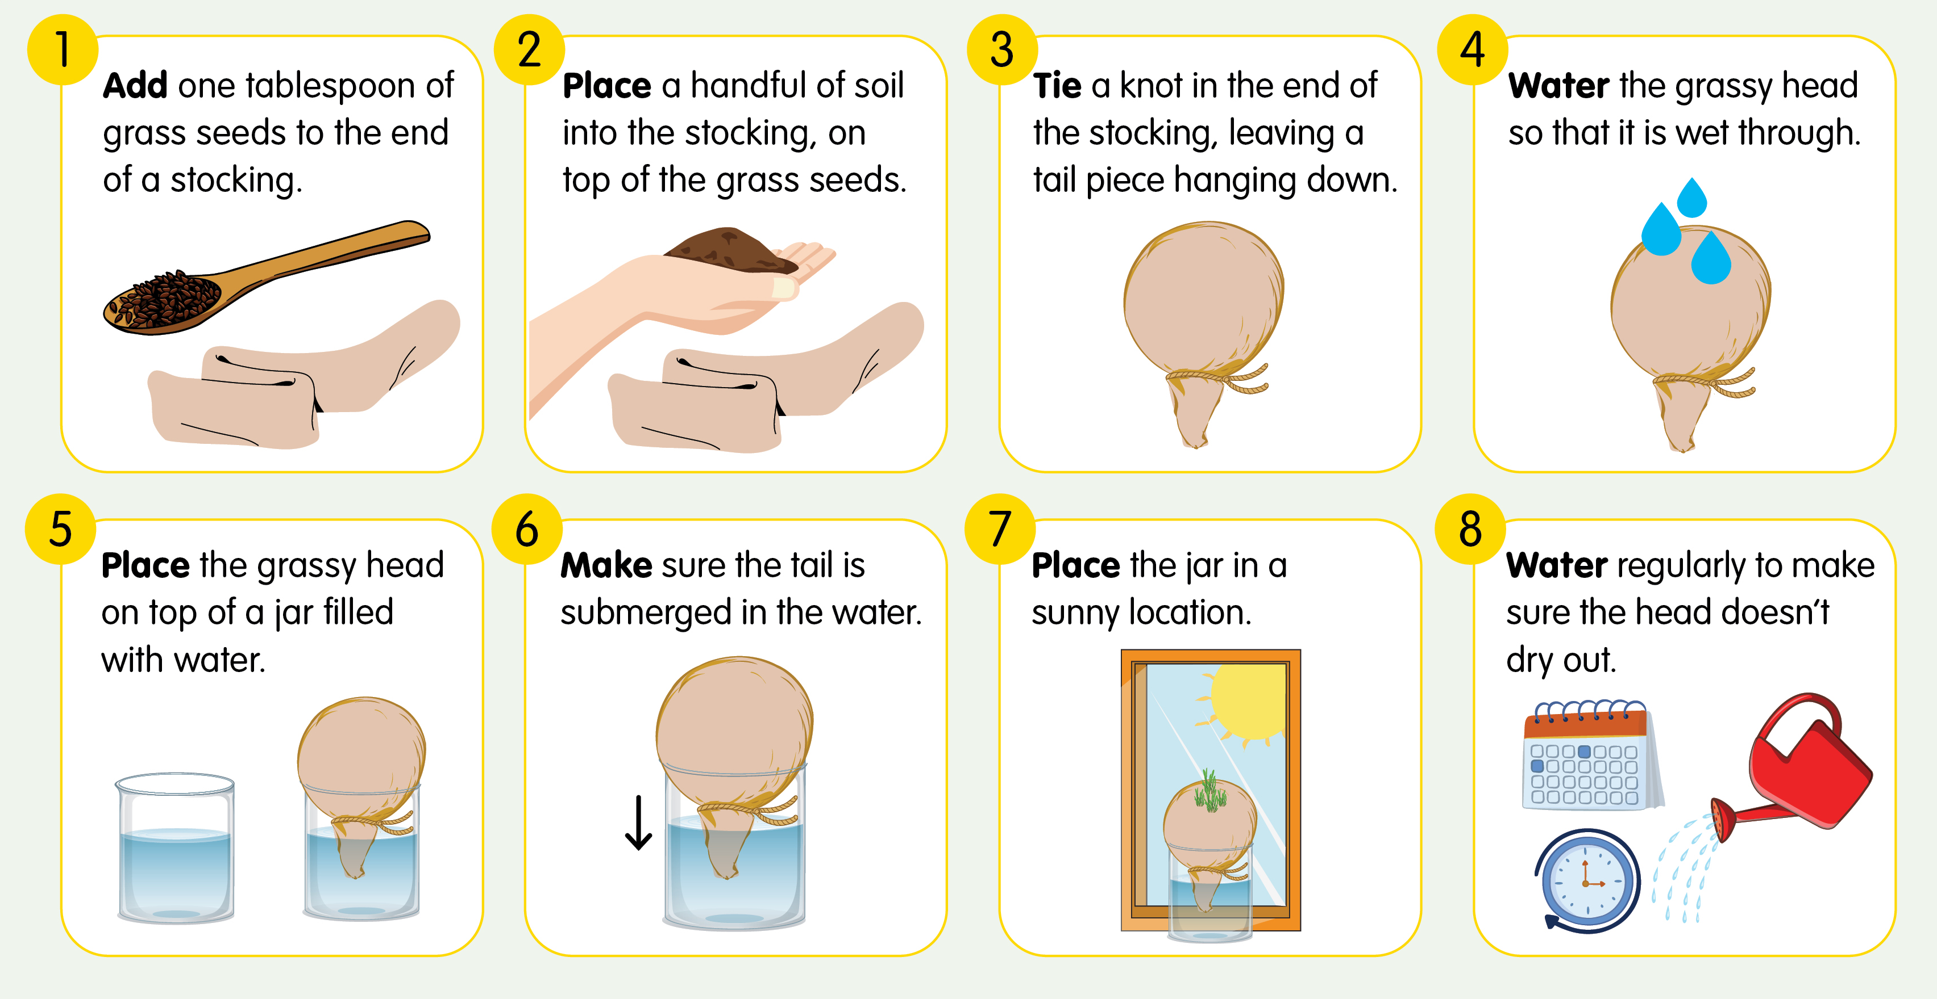
How to make a grassy head

Slide 24
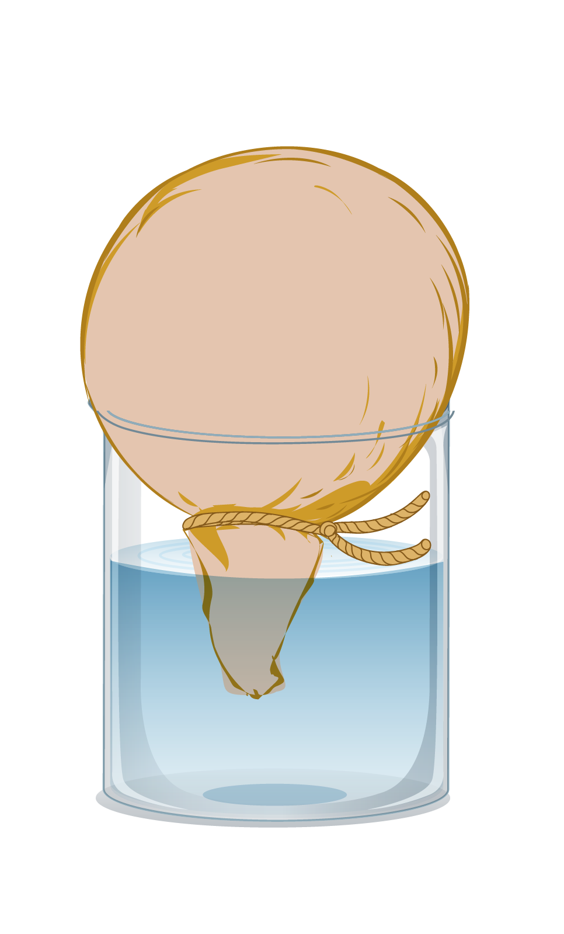
Let’s investigate
We are going to conduct an experiment to see how worms help plants to grow.
1. Collect two stockings and two glass jars.
4. Follow the rest of the instructions on How to make a grassy head to finish.
2. In the first stocking, place one tbsp of grass seeds and a handful of garden soil.
5. Label each jar so you know which is which.
3. In the second stocking, place one tbsp of grass seed, half a handful of soil and half a handful of worm castings.
6. Observe and record what happens to the grassy heads over the next few weeks.
Let’s predict what we think will happen?

Slide 25
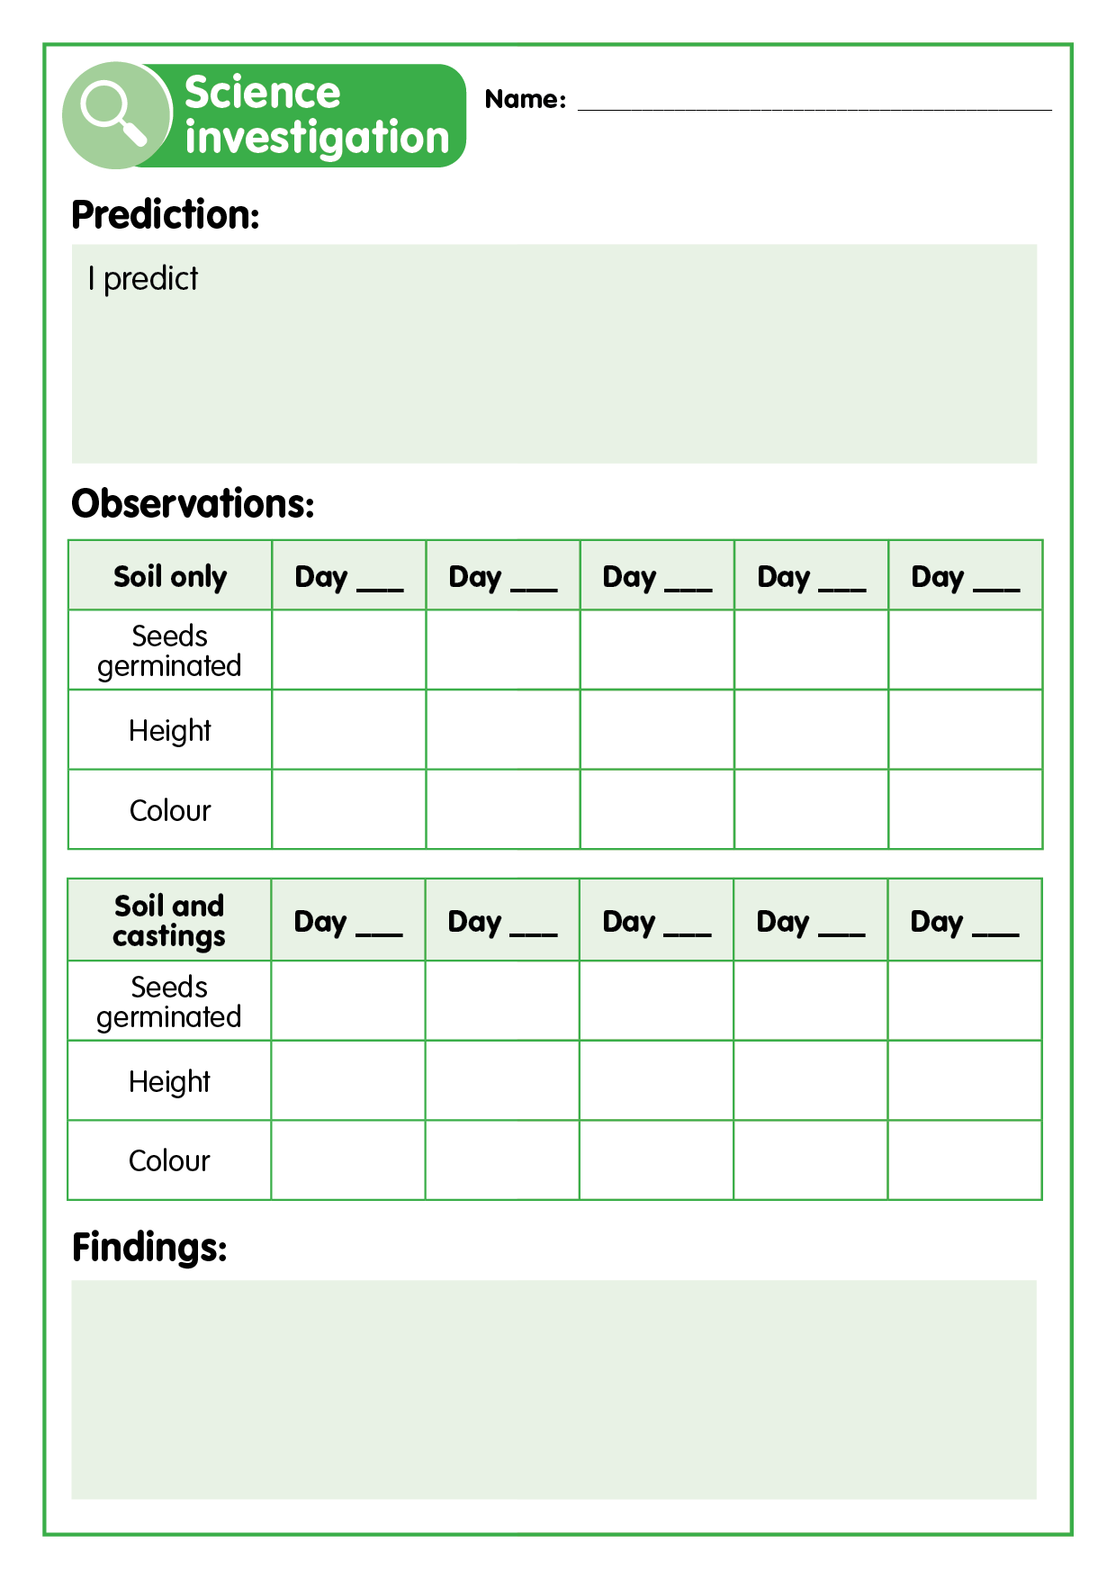
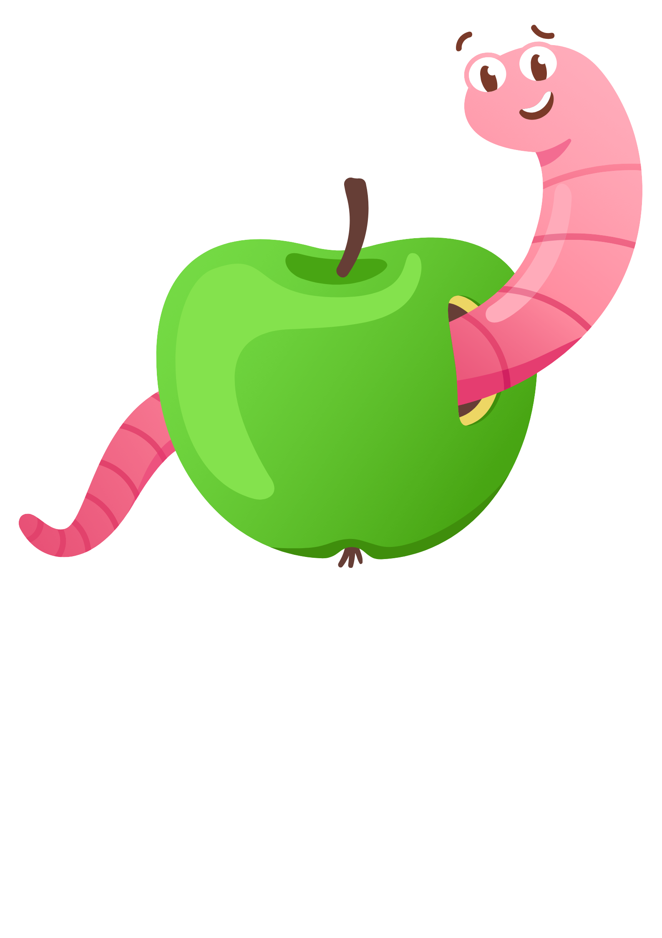
Let’s record
Check your grassy heads regularly and record your observations in a table like the one shown.
Record how many seeds have germinated.
Record how much the grass has grown.
Record any changes in the colour of the grass.
Making it digital
Use a digital device to take photos of the changes to the grassy heads to create a visual timeline.
Create a table digitally using an app of your choosing and use this to record your observations.

Slide 26
Let’s discuss
Which stocking head grew ‘hair’ the fastest?
Why do you think this is?
Did your findings match your predictions?
Why/why not?
What does this tell us about the effect of worm castings on plants?
Why would it be good to have worms in your garden?
What should we do with worm castings at school?
If you had your own garden, would you use worm castings on it? Why?

